Slide 1



FII DII ACTIVITY
Last data refresh:
2/11/2023 1:31:07 PM UTC
Downloaded at:
2/11/2023 5:05:26 PM UTC

Slide 2
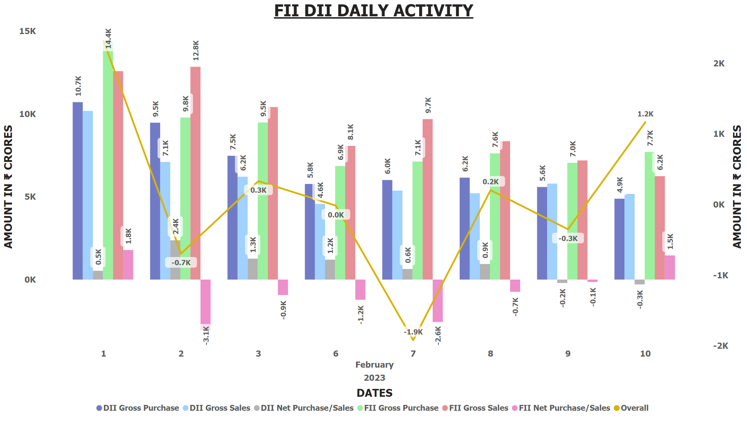
FII DII DAILY DETAILS
Notes:
FII DII DAILY ACTIVITY
No alt text provided

Slide 3
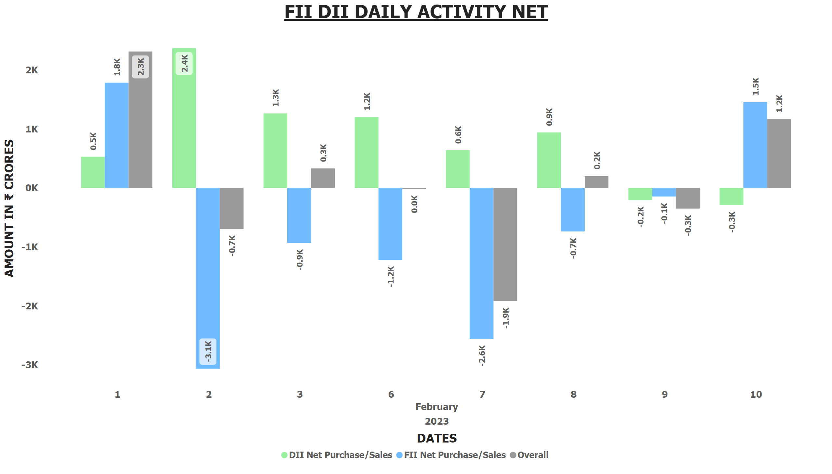
FII DII DAILY NET
Notes:
FII DII DAILY ACTIVITY NET
No alt text provided

Slide 4
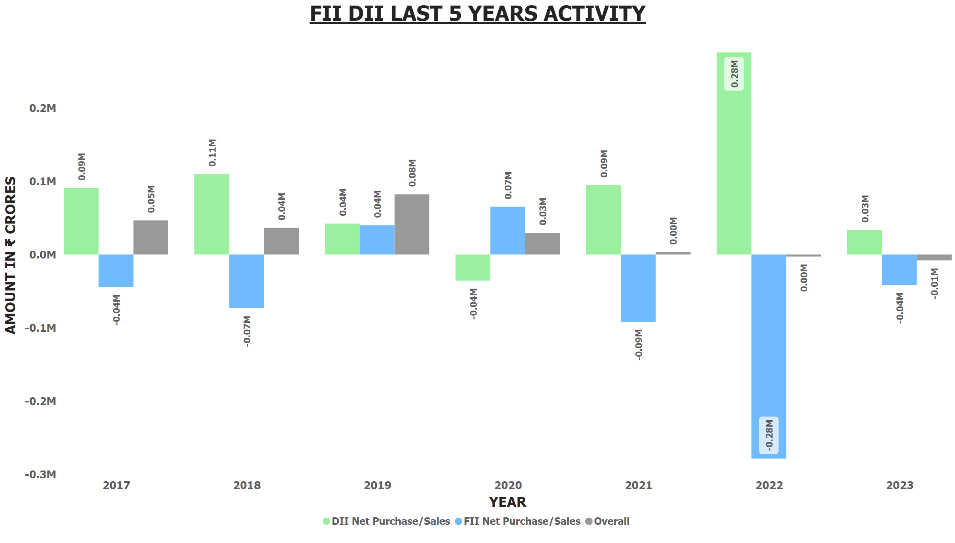
FII DII 5 YEARLY
Notes:
FII DII LAST 5 YEARS ACTIVITY
No alt text provided

Slide 5
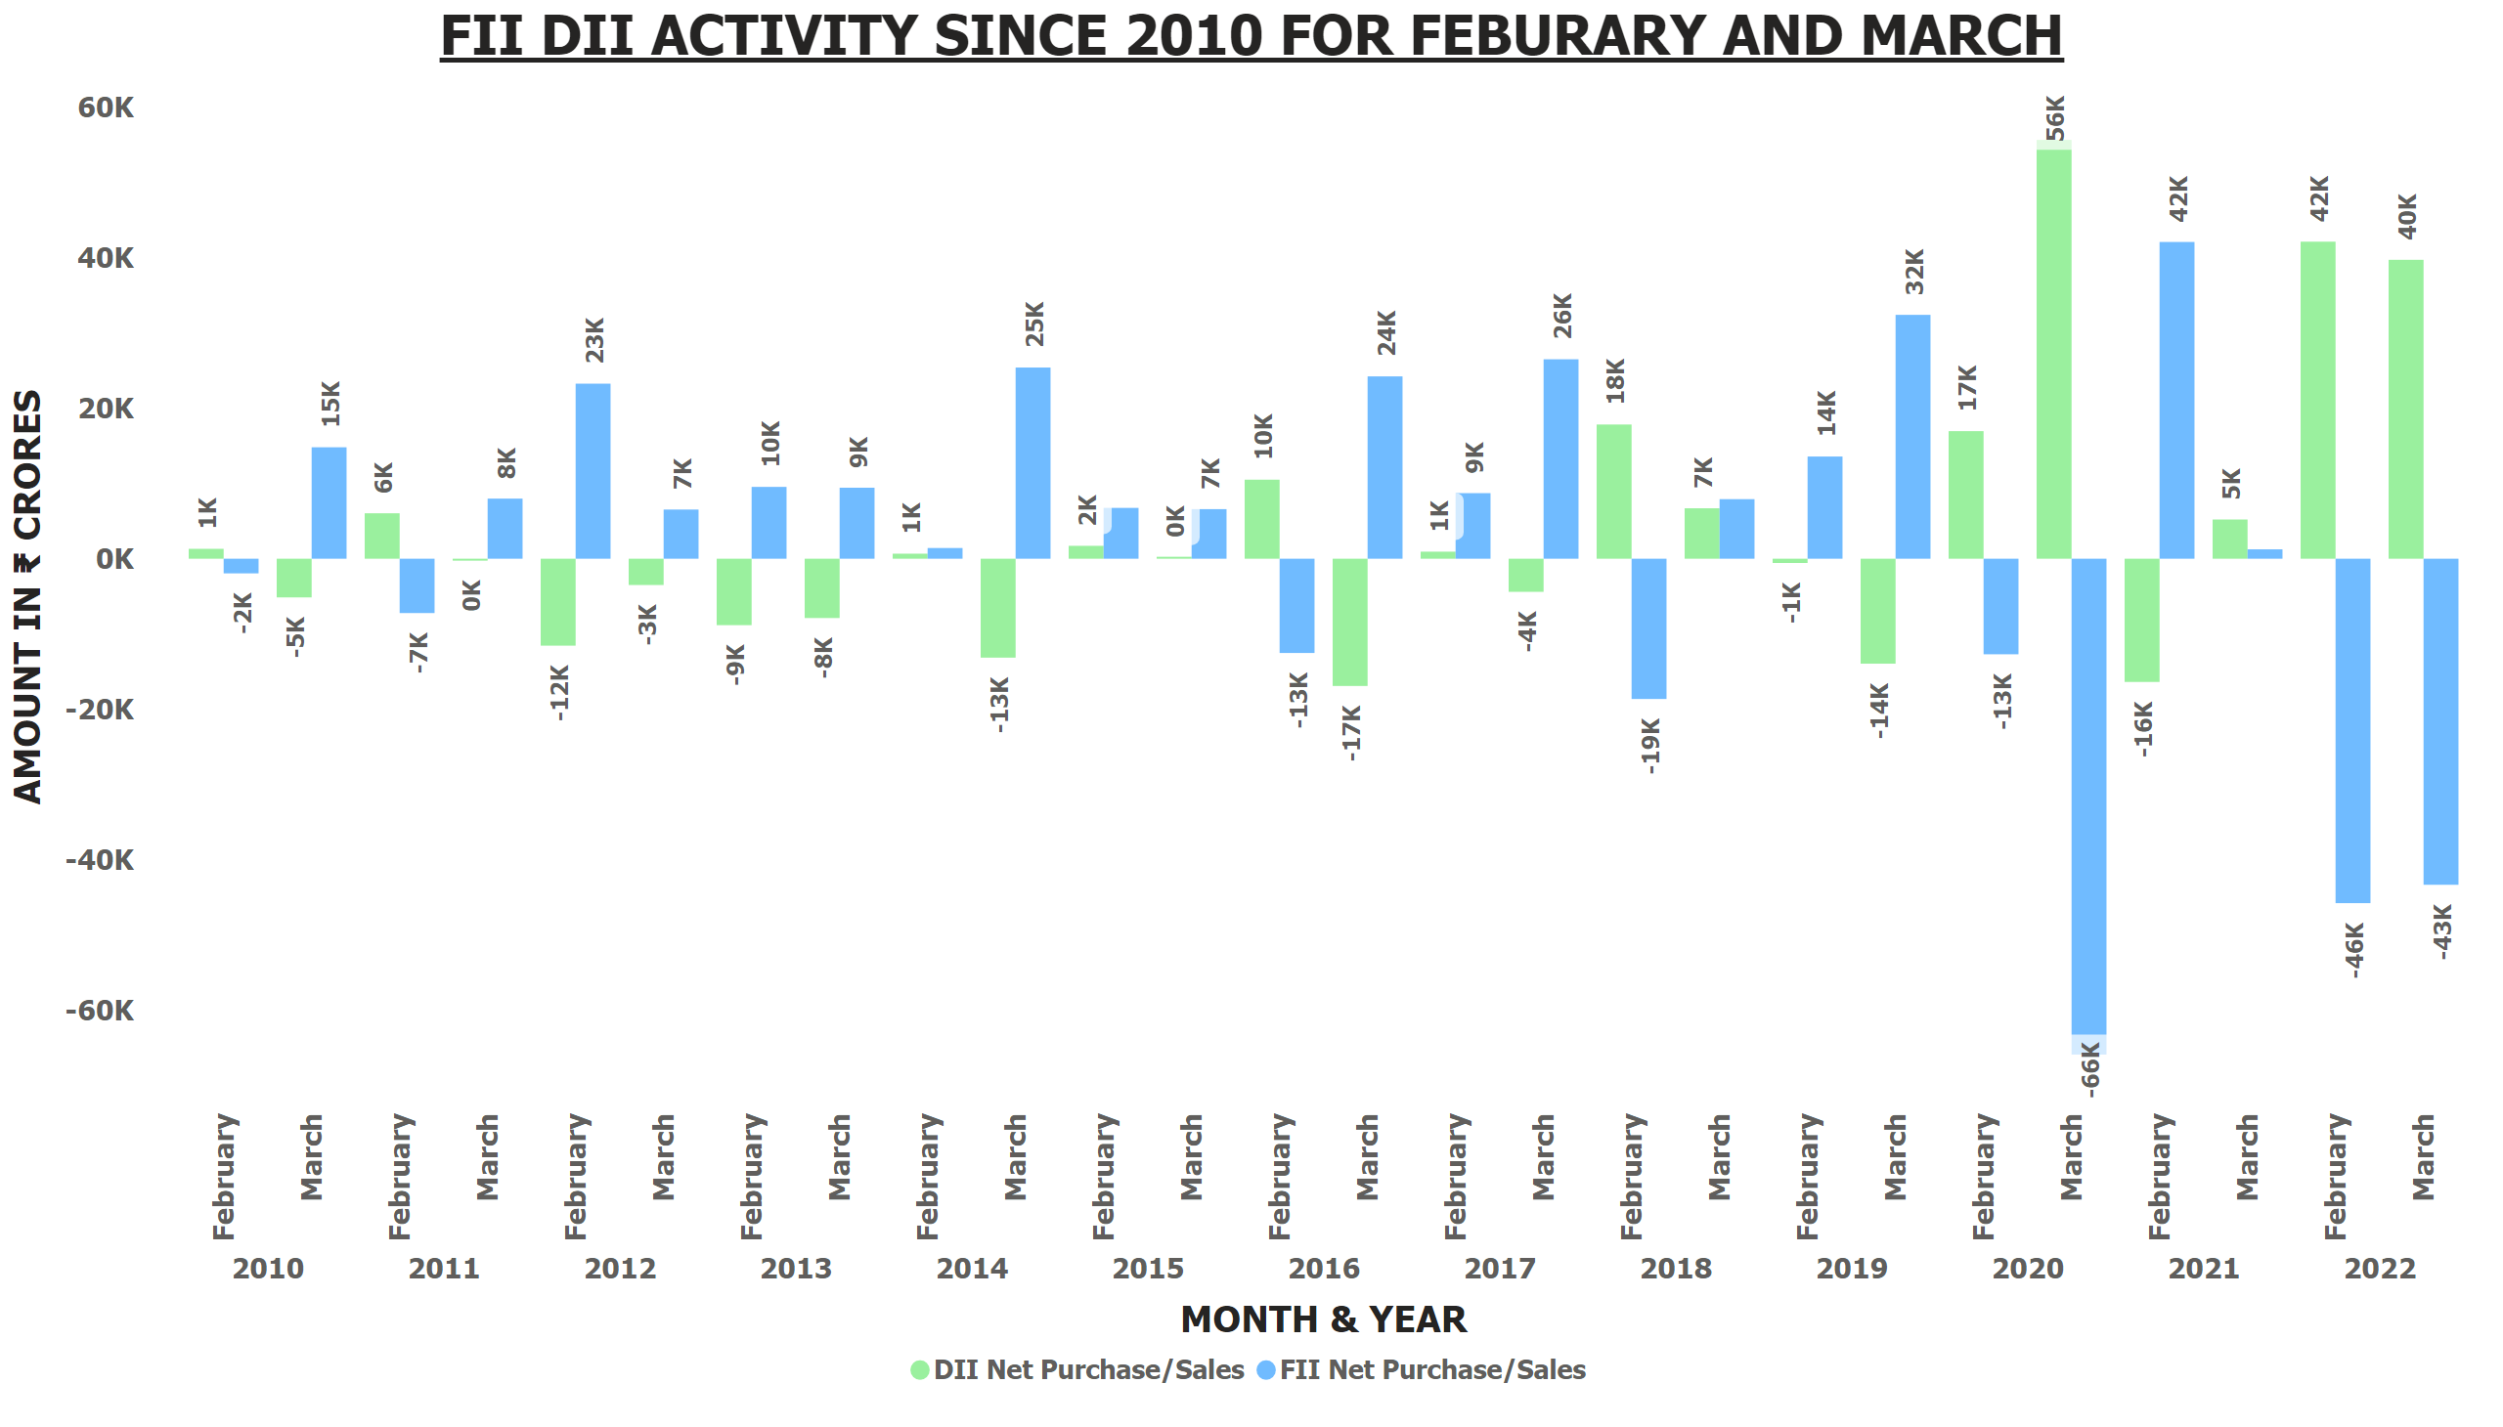
FII DII 12 YEARS JAN FEB
Notes:
FII DII ACTIVITY SINCE 2010 FOR FEBURARY AND MARCH
No alt text provided

